Slide 1
Safe regression test selection for Modelica
By Erik Hedblom and Kasper Rundquist

Slide 2
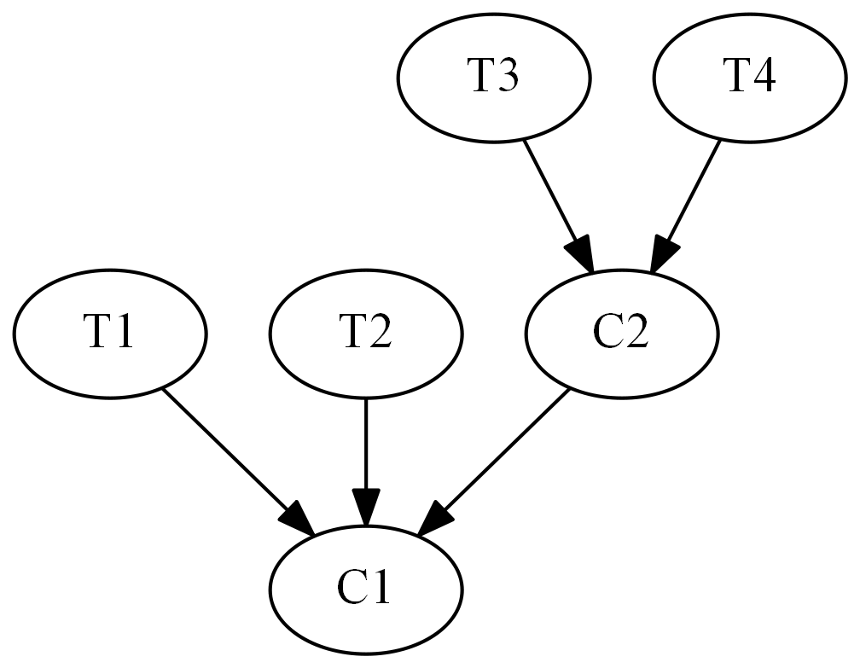
Safe test selection
Notes:
Safe: garantera att alla tester som skulle kunna misslyckas faktiskt körs
Naiv metod: kör alla tester
Lång tid att köra alla tester
Inverterade beroenden

Slide 3


Modelon
Jmodelica.org
OPTIMICA Compiler Toolkit
Model Testing Toolkit

Slide 4
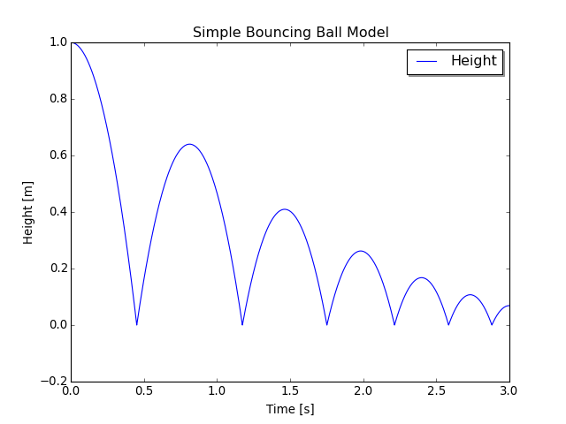
Modelica Bouncing Ball example
model BouncingBall //The 'classic' bouncing ball model
parameter Real e = 0.8; //Elasticity coefficient
parameter Real g = 9.81; //Acceleration due to gravity
Height h(start=1); //Height of the ball
Velocity v(start=0); //Velocity of the ball
equation
der(h) = v; //Newtons second law
der(v) = -g;
when h <= 0 then
reinit(v, -e*pre(v)); //Set velocity after bounce
end when;
end BouncingBall;

Slide 5
Source tree name lookup limitations
package P
model M1
replaceable package P0 = P1;
function f = P0.f;
end M1;
model M2
M1 m(replaceable package P0 = P2);
Real y = m.f (10);
end M2;
end P;

Slide 6
Dependency rules
A class depends on all classes referenced by resolvable accesses within it, not including accesses within paths.
A class depends on its enclosing class.
A class depends on all classes referenced by access paths within it. A unresolvable access can still contain resolvable accesses within its path.
A class depends on all classes enclosed by an accessed class. This does not include access within paths but if an access is not resolvable, the last resolvable access in the path will be used instead.
Exception to Rule 4: Rule 4 is not applicable to import statements.

Slide 7
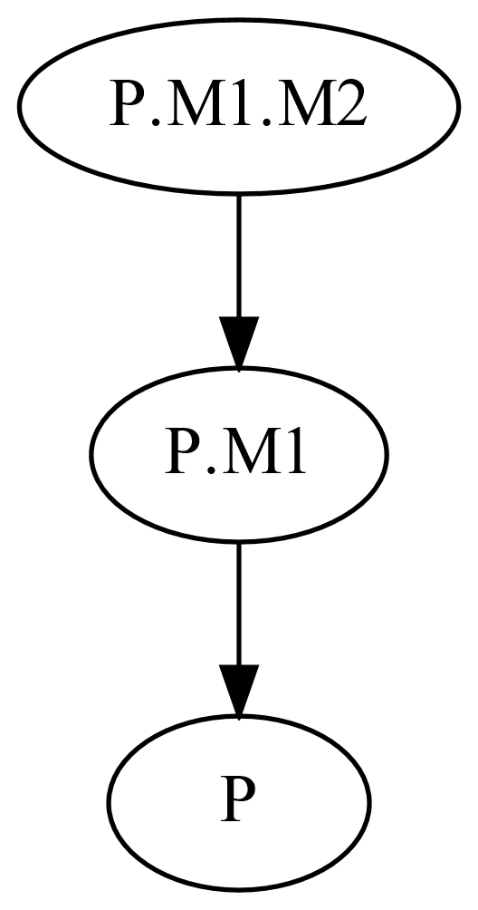
Dependency rules
2. A class depends on its enclosing class.
package P
constant Real k = 1;
model M1
model M2
Real x = k;
end M2;
end M1;
end P;

Slide 8
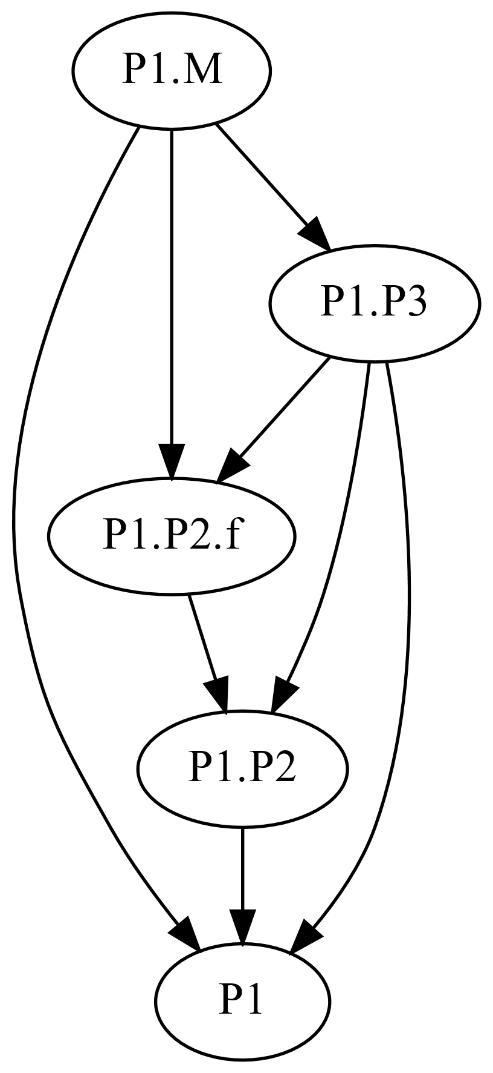
Dependency rules
3. A class depends on all classes referenced by access paths within it. A unresolvable access can still contain resolvable accesses within its path.
package P1
package P2
function f
input Real x;
output Real y;
algorithm
y := x;
end f;
end P2;
package P3
extends P2;
end P3
model M
Real x = P3.f(0);
end M;
end P1;

Slide 9
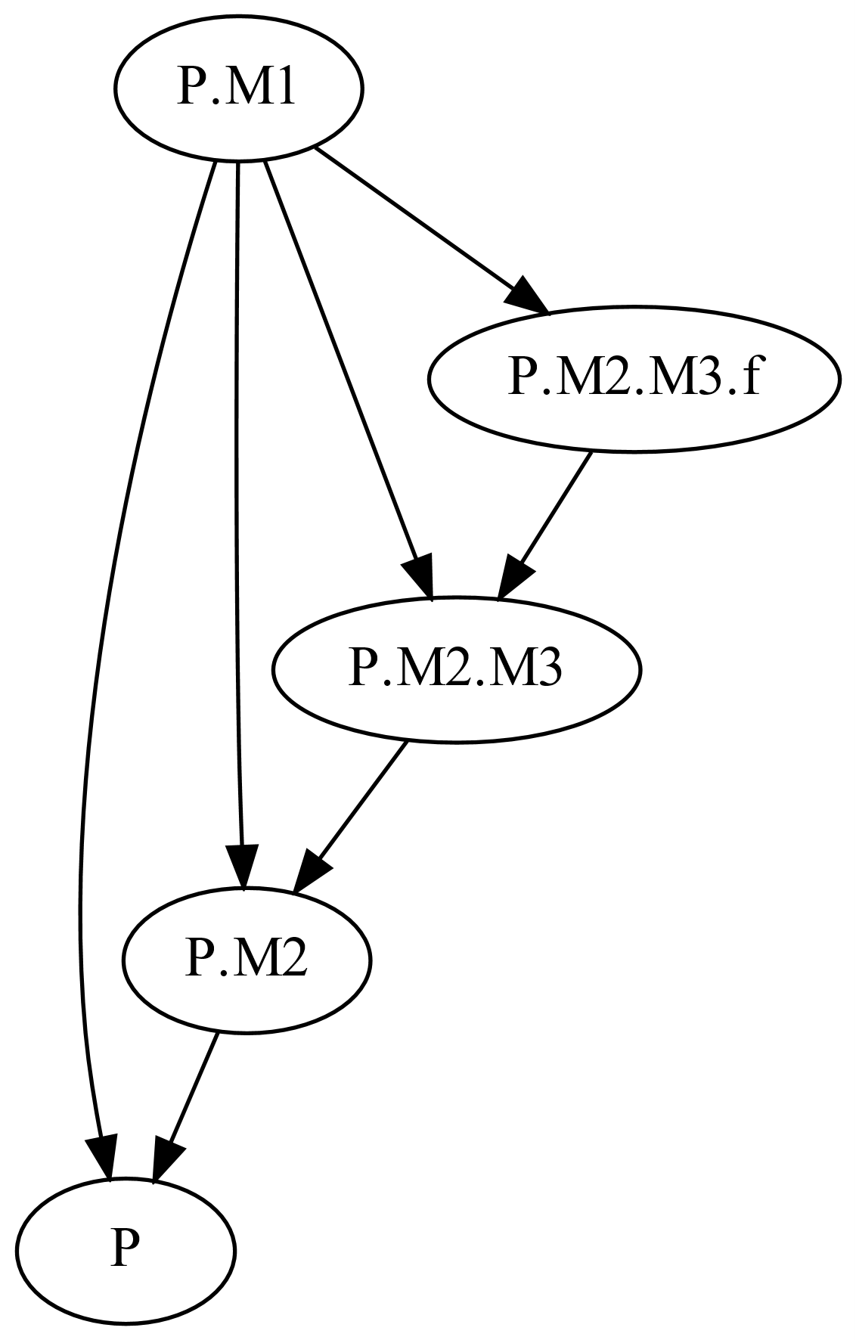
Dependency rules
4. A class depends on all classes enclosed by an accessed class.
package P1
constant M m;
model M
function f
input Real x;
output Real y;
algorithm
y := x;
end f;
end M;
package P2
Real x = P1.m.f(1);
end P2;
end P1;

Slide 10
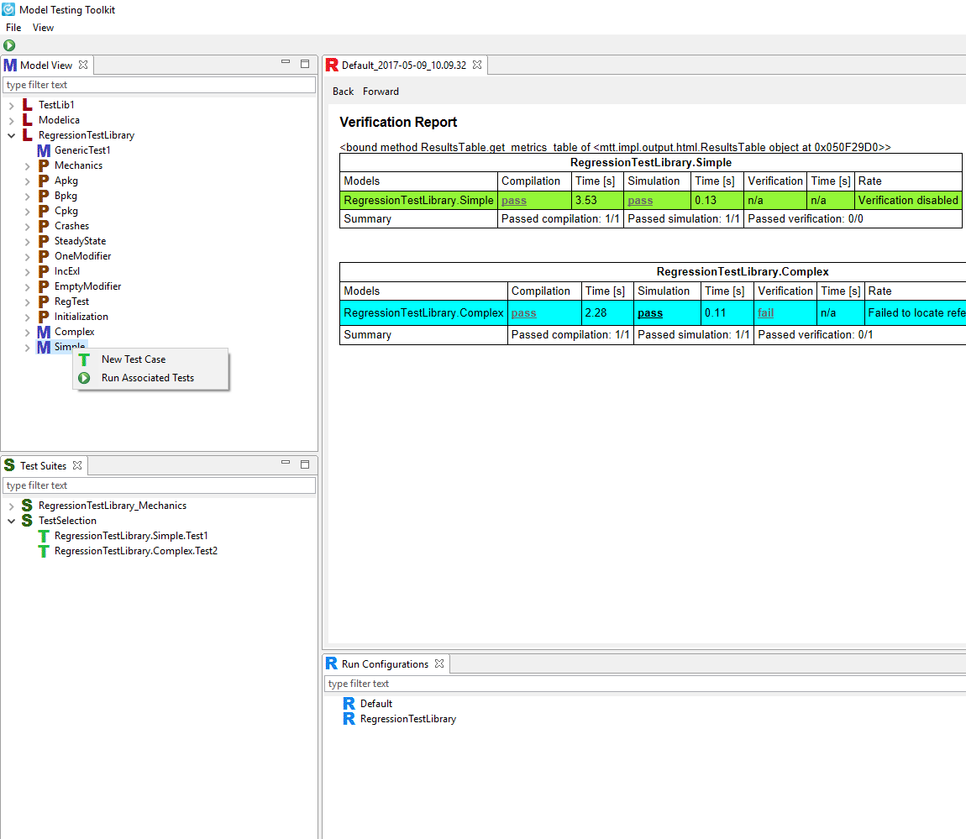
Implementation
Notes:
External functions
Change detection

Slide 11
Evaluation

Slide 12
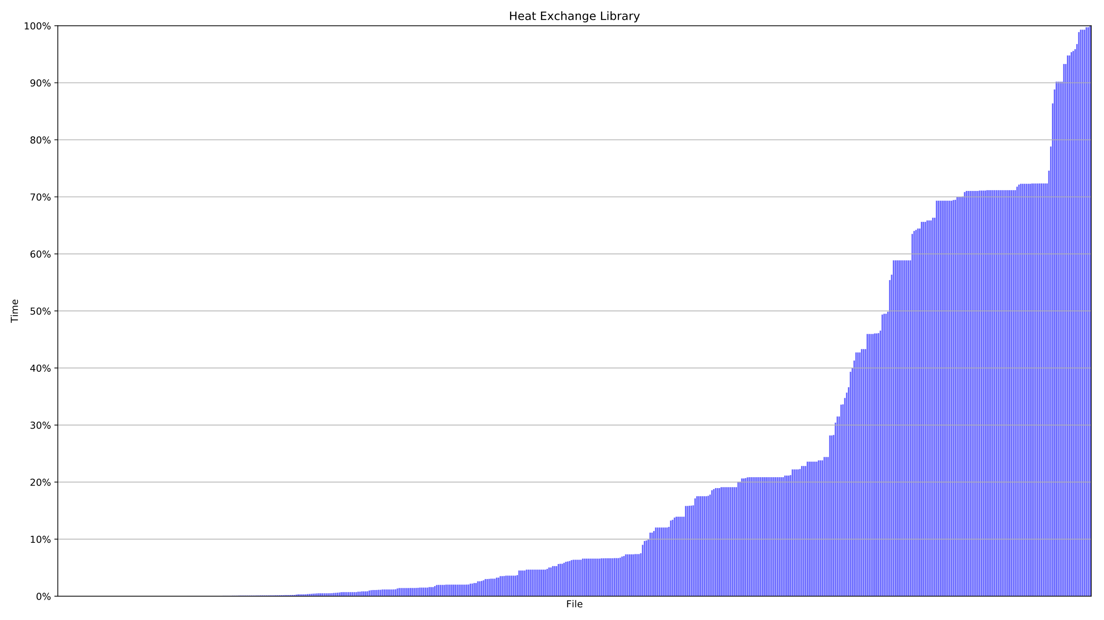
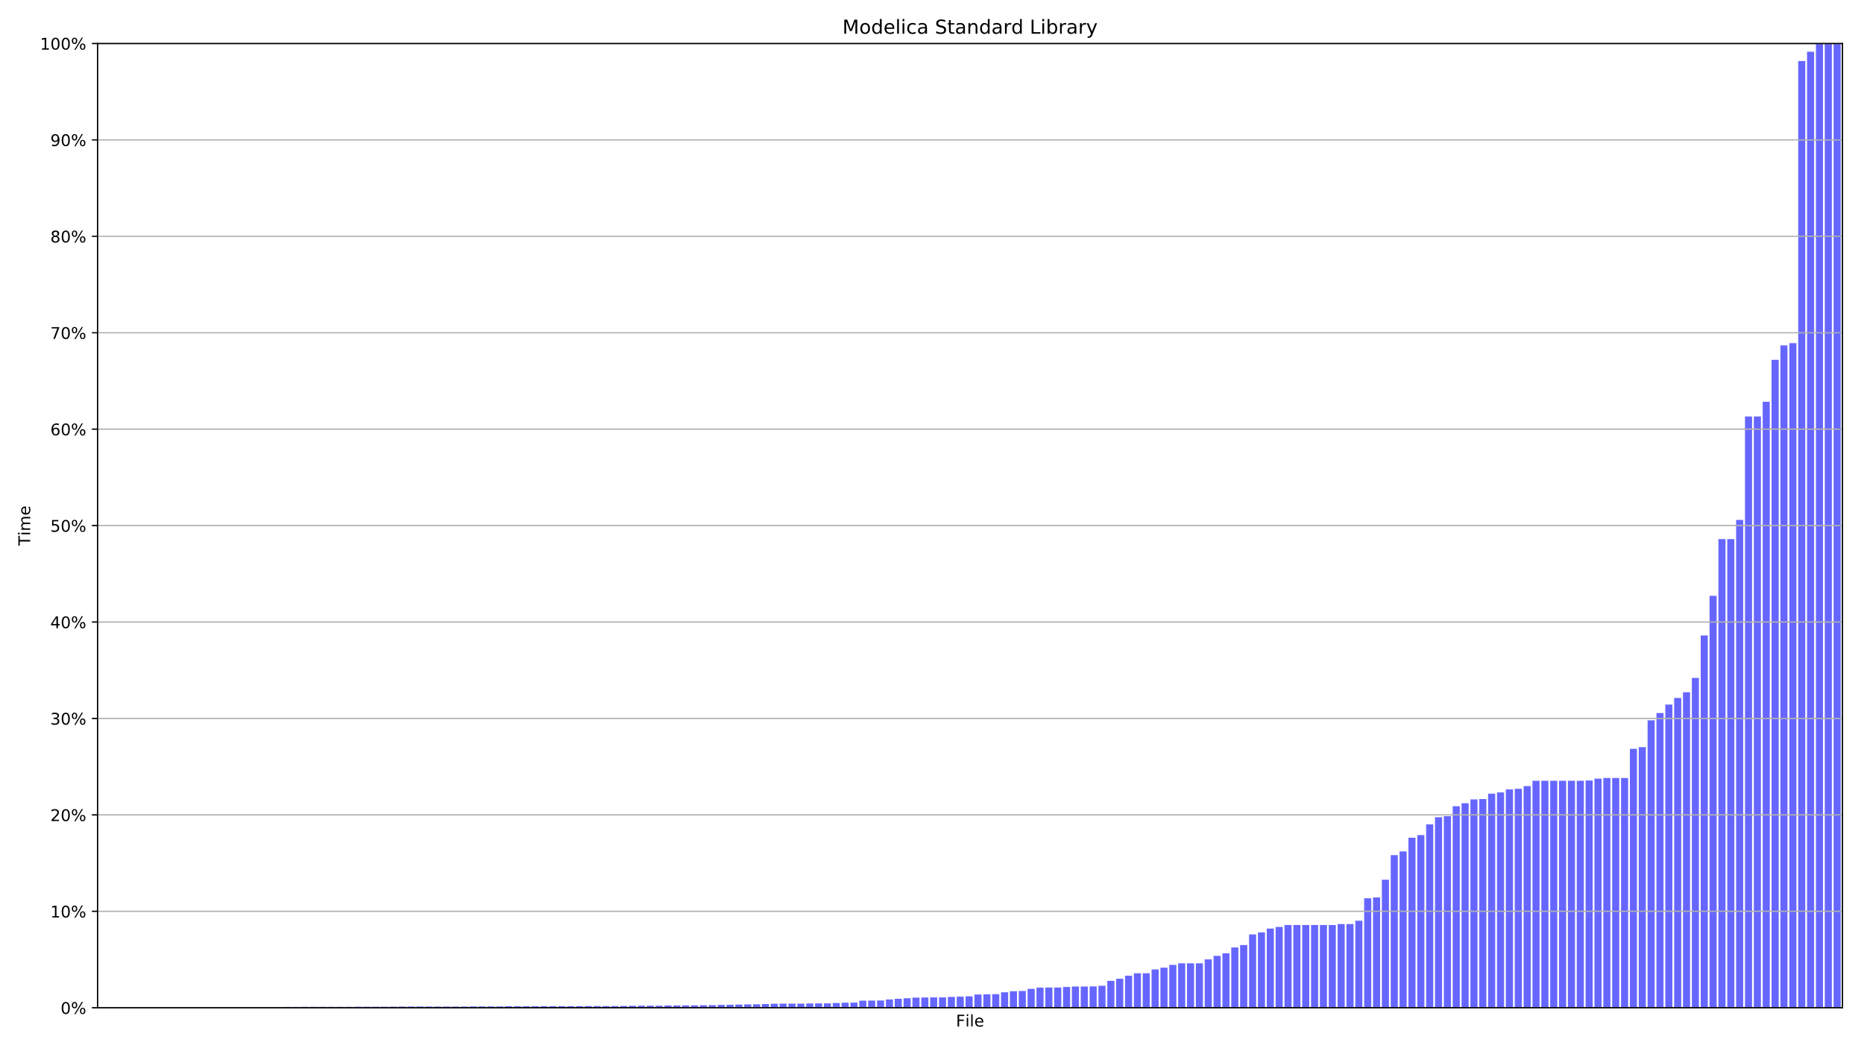
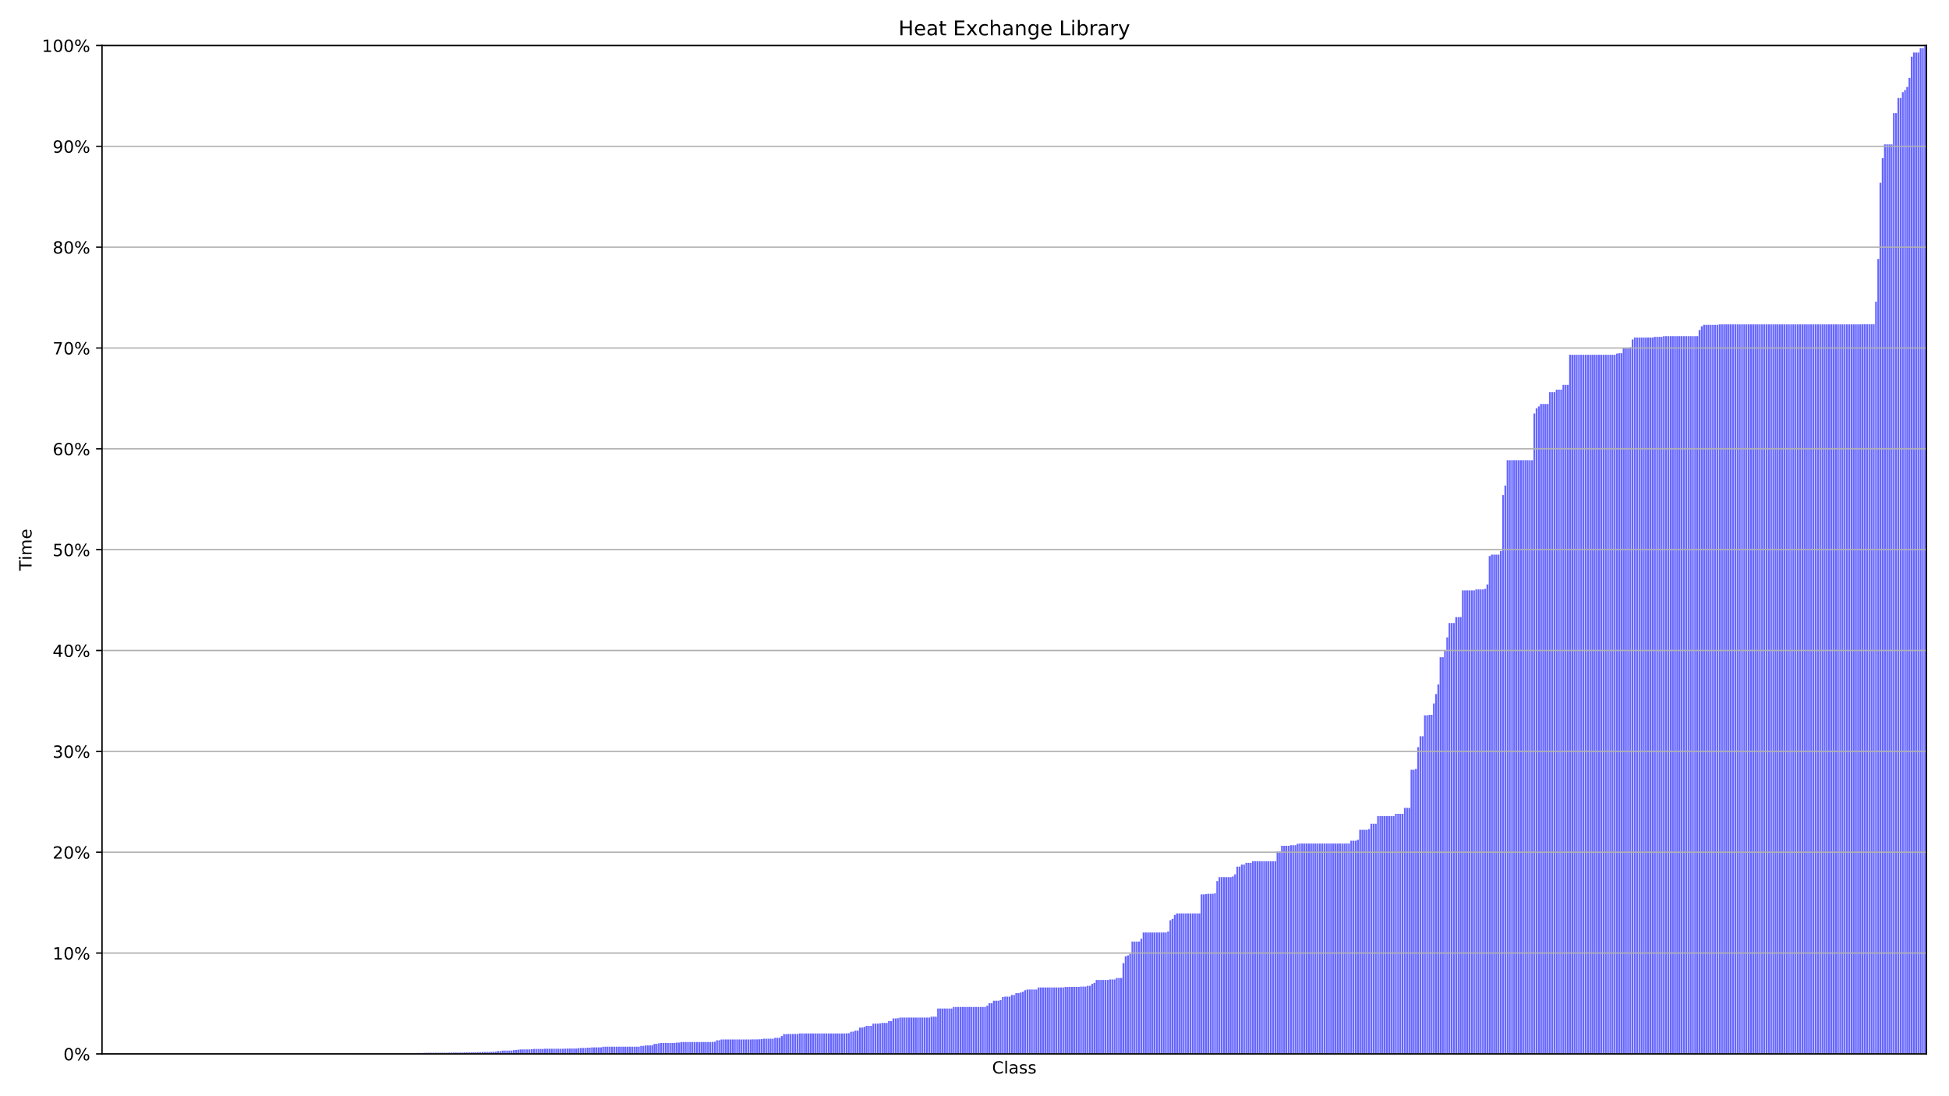
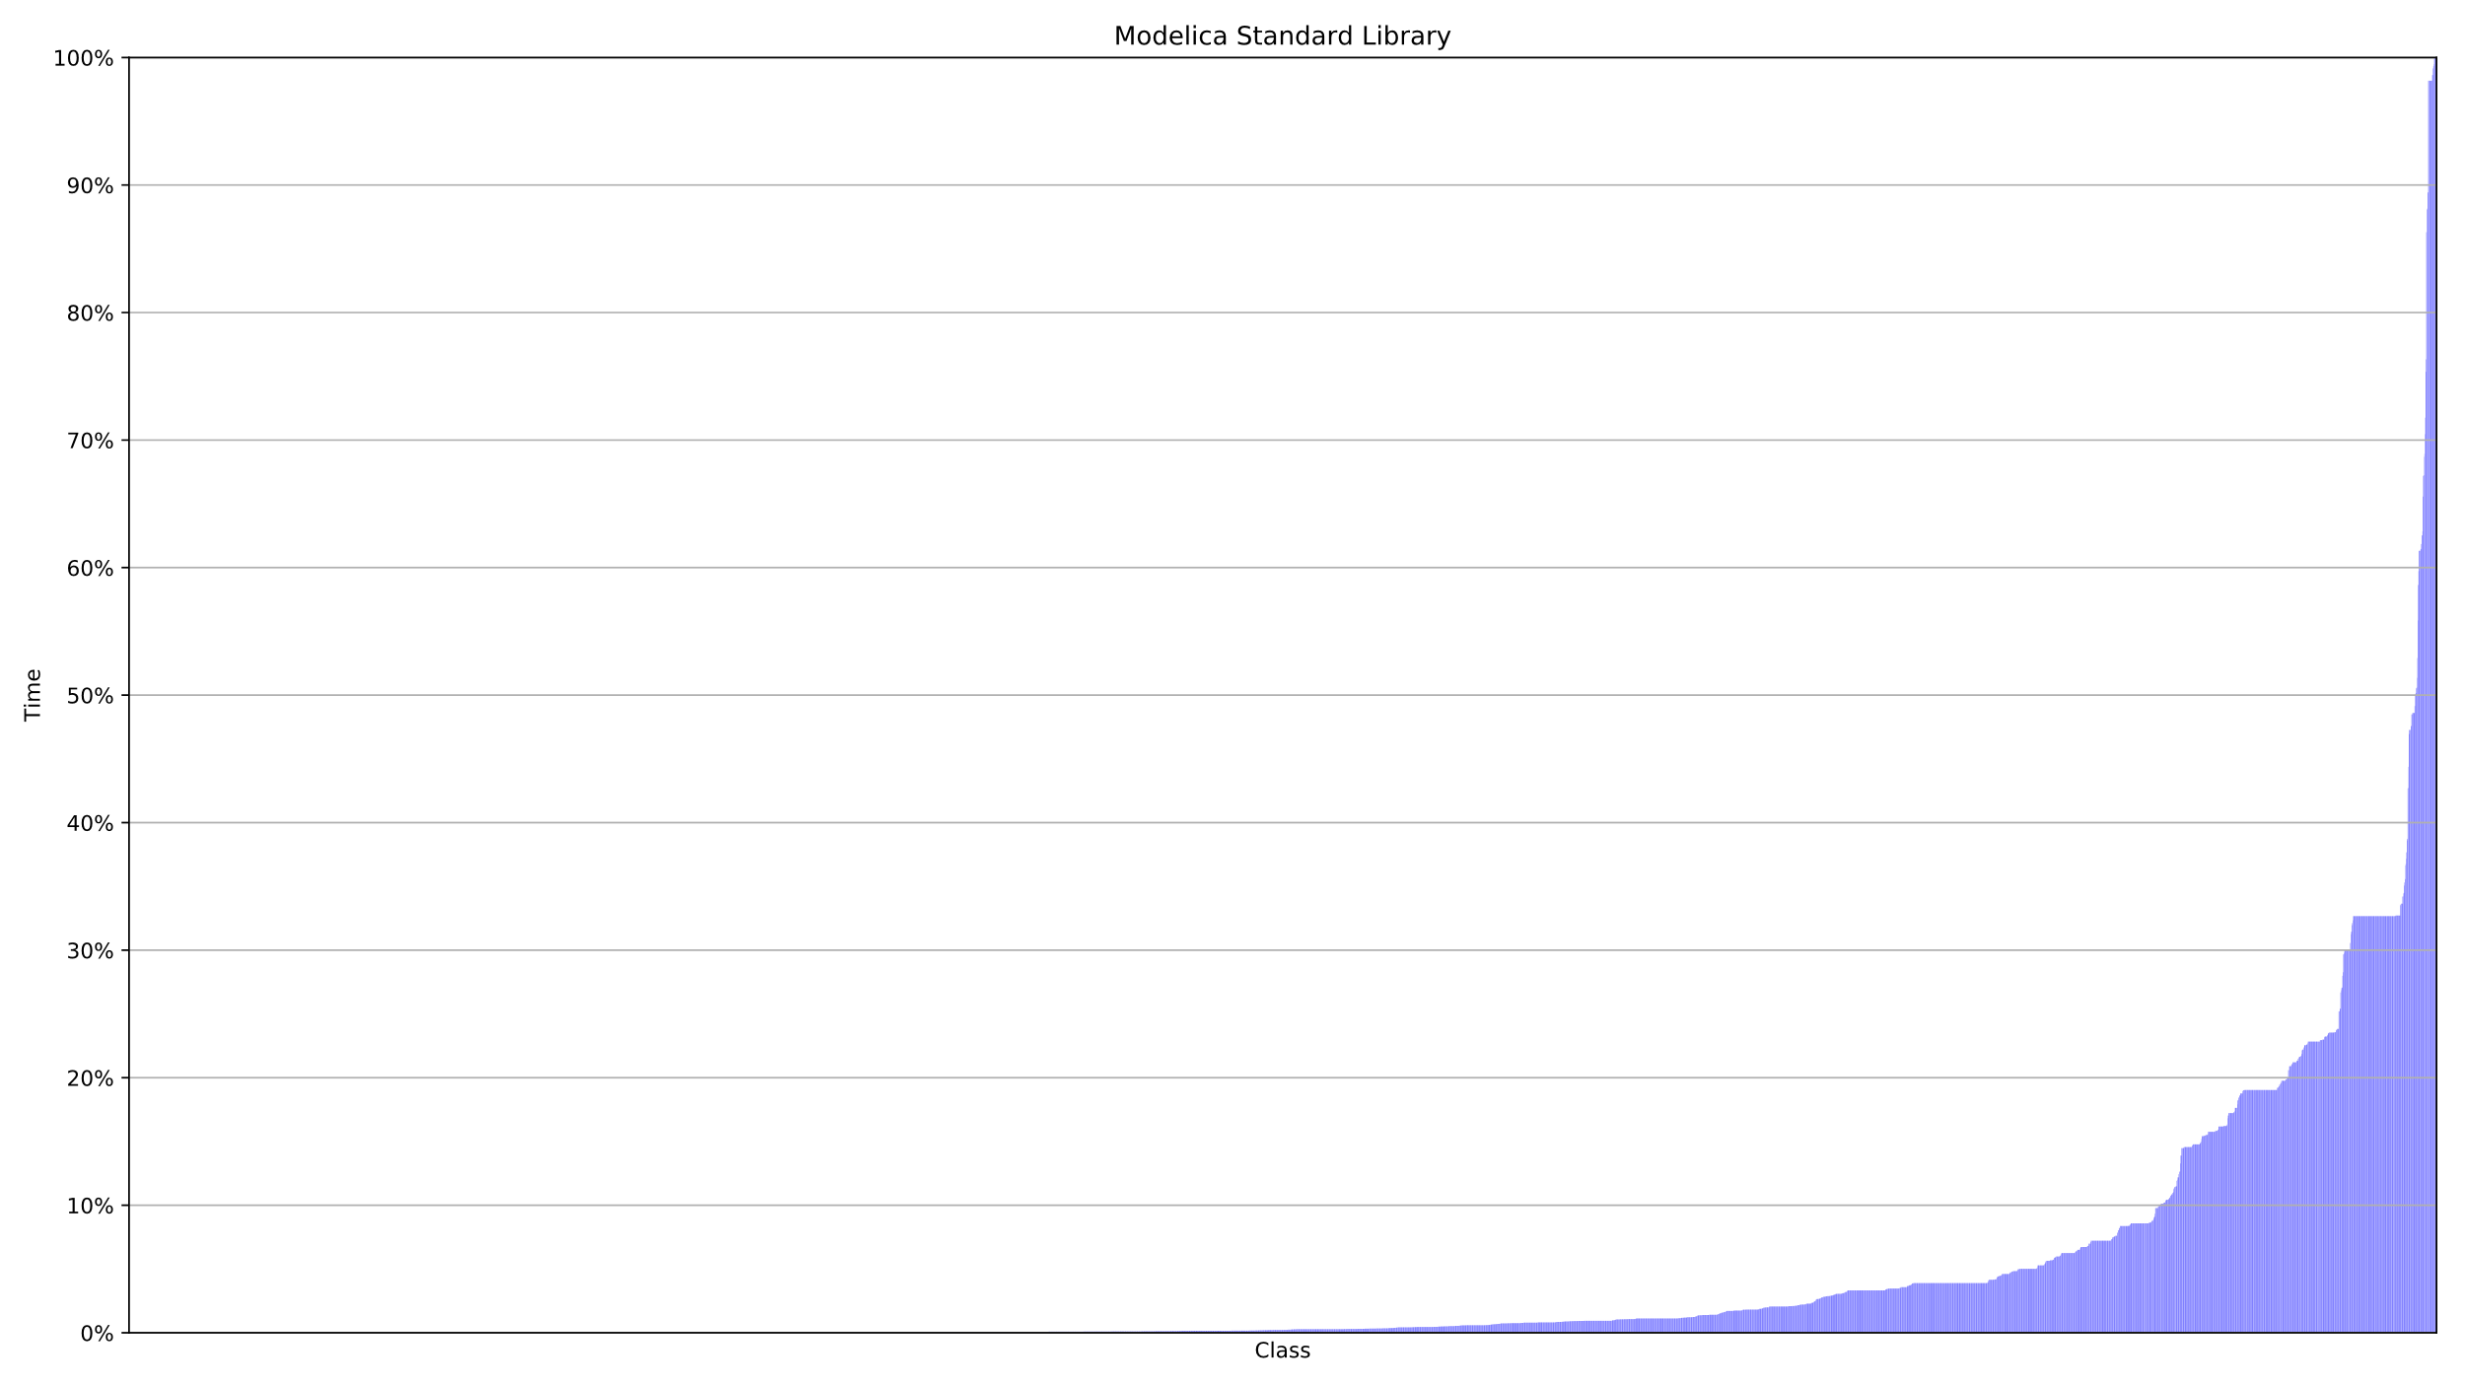
Resultat filer och klasser

Slide 13
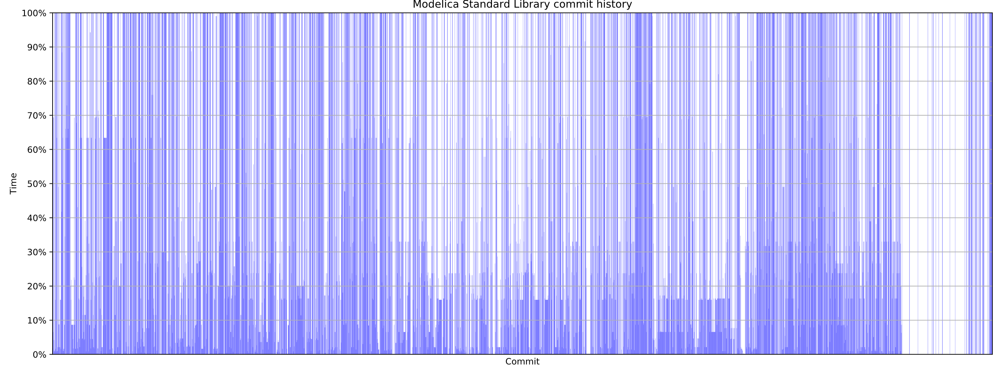
Evaluation

Slide 14
Evaluation
 | Units | Complete testsuite execution time | Dependency analysis exectution time | Average time savings
HXL | 552 files | 3h 1m 51s | 6.7s | 68%
 | 819 classes |  |  | 67%
MSL | 197 files | 2h 26m 36s | 18.8s | 88%
 | 5917 classes
 |  |  |  | 93%
 | 4341 commits
 |  |  |  | 56%

Slide 15
Validation/Future work
Run testselection in paralell with complete testsuite
Mutation testing
Move implementation to instance tree?

